Slide 1
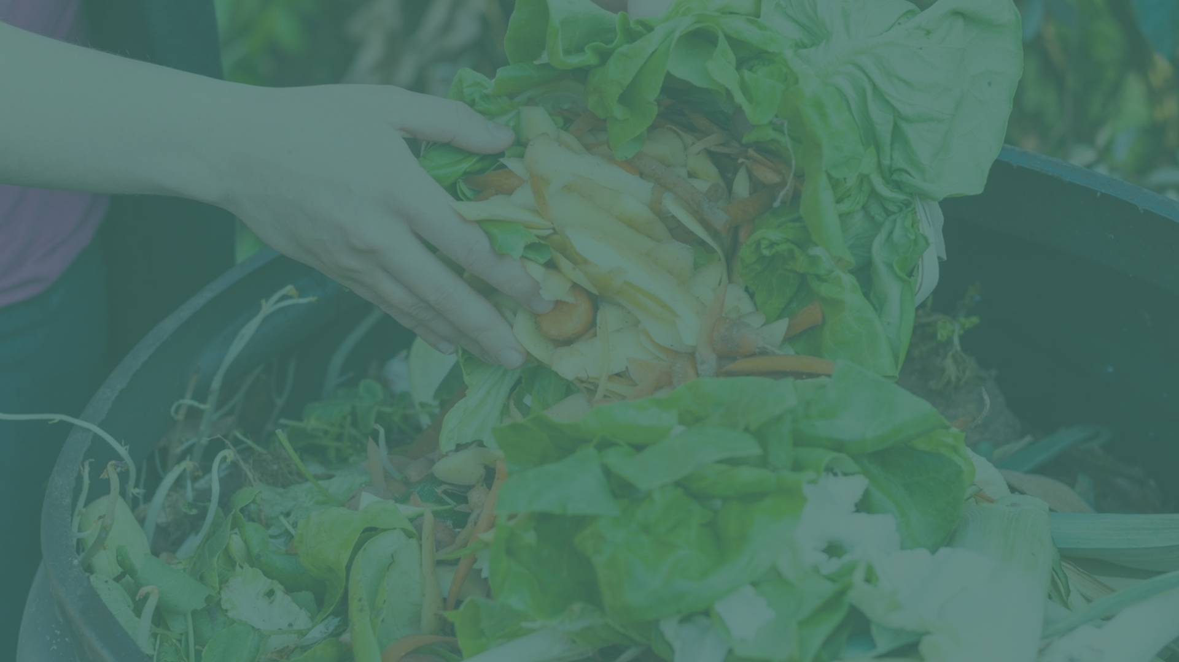
Re Food - Waste to Wealth

Slide 2
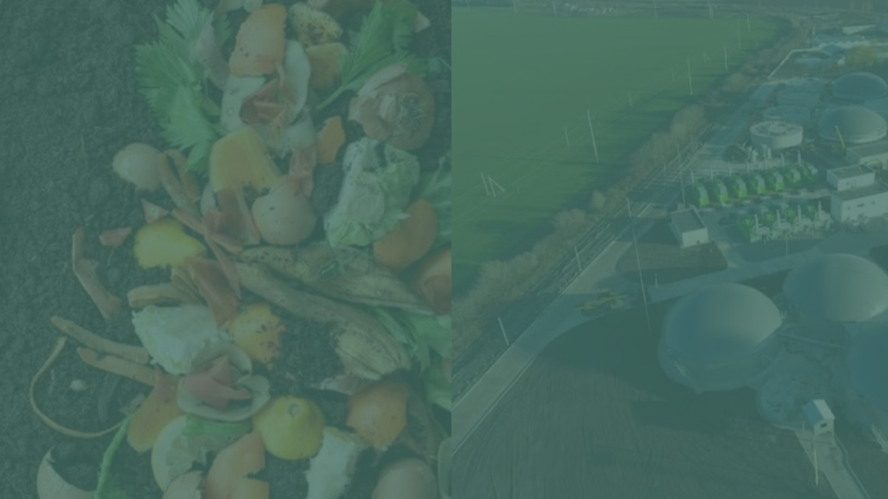
Presented By:
K. Kusuma Manjari
M. Hari Krishna
J. Jyothi Swaroop
B. Ashish
K.Paul Raju

Slide 3
Abstract
This project proposes a web-based platform to address the challenge of managing waste food by facilitating its collection from hotels and its utilization by industries dedicated to repurposing food waste. Large amounts of surplus food often end up in landfills, contributing to greenhouse gas emissions and resource depletion. The platform acts as a mediator, connecting hotels with industries that can use surplus food for various purposes such as animal feed, composting, bioenergy production, or food processing. Hotels will list their surplus food items on the platform, specifying quantities, expiration dates, and pickup availability. Industries registered on the platform can browse listings and express interest in acquiring specific food items for their operations. Some key features include a user-friendly interface for hotels to manage listings and secure communication channels for negotiation. The web-based platform provides a scalable and sustainable solution for hotel food waste management, encouraging collaboration among stakeholders in the hospitality and industrial sectors.

Slide 4
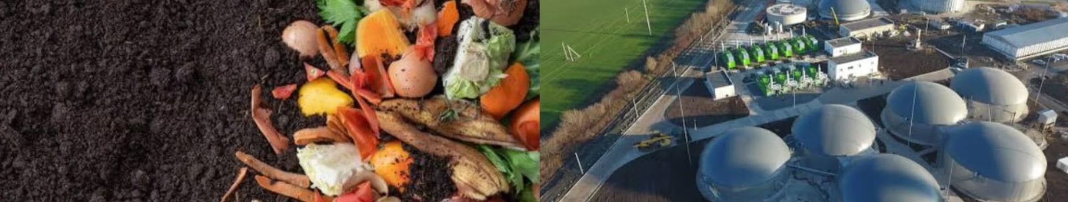
Problem Statement
There exists a lack of efficient communication and collaboration between hotels which generate surplus food and industries which can utilize this surplus to produce biogas and vermicompost from organic waste. This disconnect results in missed opportunities for resource recovery in industries.

Slide 5
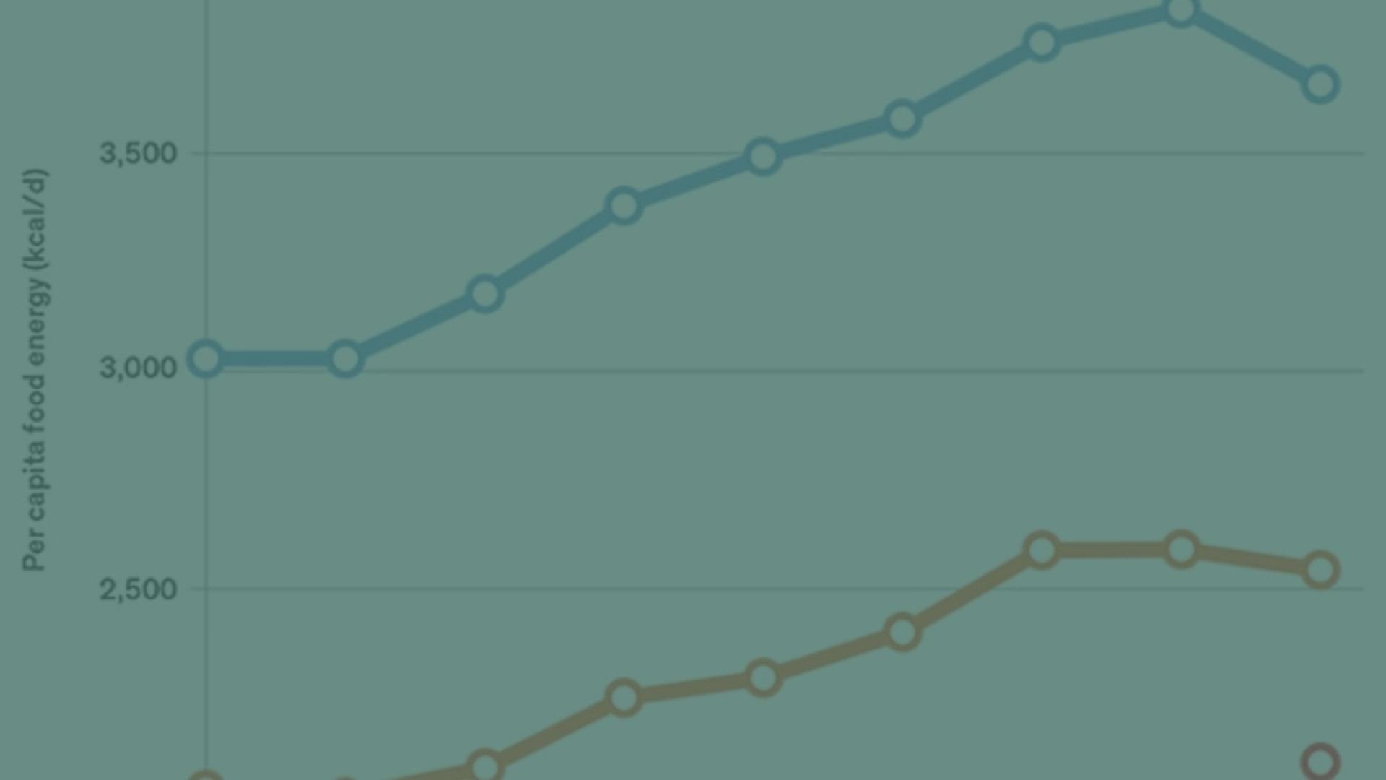

According to the UNEP's (United Nations Environment Programme) food wastage index report, 68.7 million tones of food is wasted annually in India, in simple words it is about 50 kgs per person
In India, 40% of the food wasted is equivalent to nearly 89,000 crore/year. This is equivalent to nearly 1% of the GDP which is depleted in the form of food wastage in India.

Slide 6
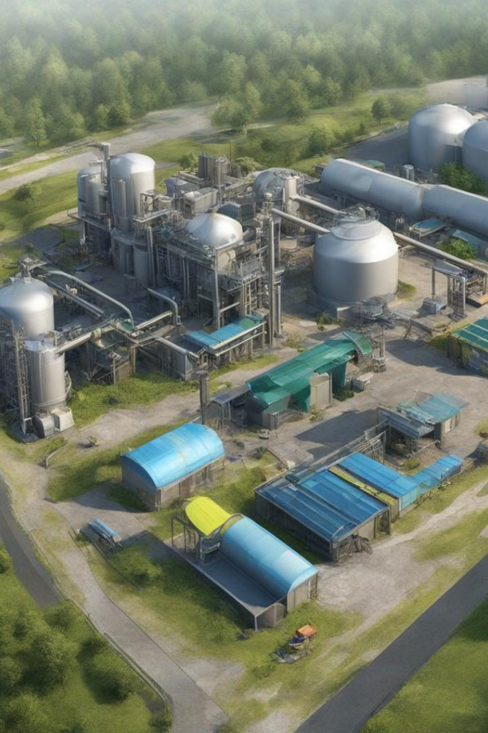
Solution
To address this challenge, we propose the development of a website that acts as a mediator between hotels and industries. The website will provide information to hotels about industries that specialize in converting leftover food and organic waste into biogas and vermicompost. Hotels can then contact these industries to arrange for the transfer of their surplus food and organic waste, reducing food waste in hotels and promoting resource recovery in industries.

Slide 7
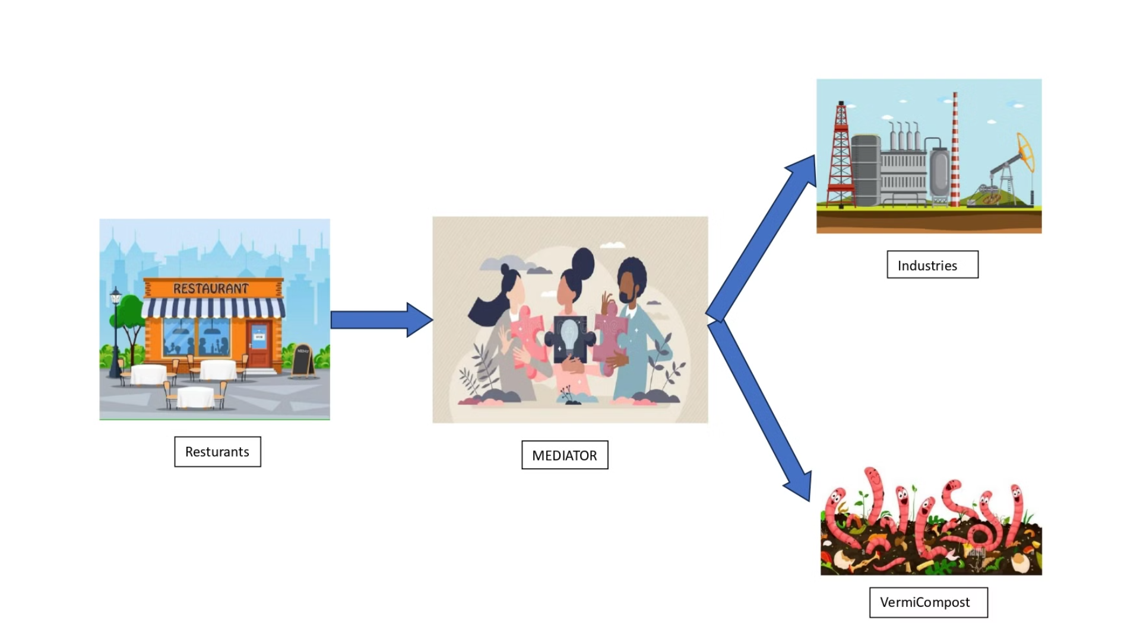

Slide 8
Proposed Website
The proposed website layout for our project presents with a header section that prominently features the project's title. Below the header lies a navigation bar, offering links to essential pages such as Home, About, How It Works, Login, Sign Up, Listings and Contact.
Beneath the navigation bar is the main content area, designed to showcase the website's primary content. It includes a welcoming message, introductory text about the project's mission and benefits, and a call-to-action button for user registration or exploring listings.
In the How It Works section, we outline a step-by-step guide or infographic explaining the process of connecting industries with surplus organic waste to hotels with surplus food. This section highlights the simplicity and efficiency of using the website.
The Listings section displays featured listings from industries and hotels. Each listing includes images and brief descriptions of the waste or food available, enticing users to browse and connect.

Slide 9
To facilitate connections, we will add a "Connect with Industries" button in the main content area. This button allows hotels to initiate contact with industries, streamlining the process of waste management and food redistribution.
Lastly, at the bottom of the page is the footer, displaying copyright information and other relevant details. The layout is designed to be responsive, ensuring readability and consistency across various screen sizes.
Overall, this proposed website layout offers a clean and structured design tailored to facilitate the efficient connection between industries and hotels for waste management and food redistribution.

Slide 10

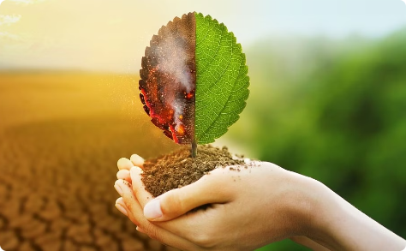
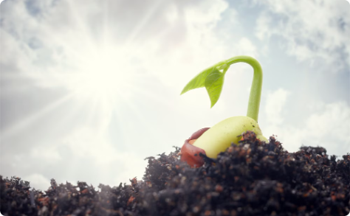
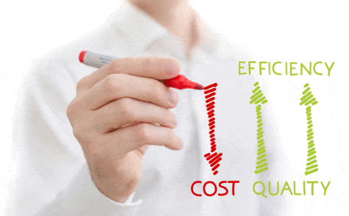

Advantages
Environmental Benefits
Enrich Soil
Fertilizers at low cost
Better Communication

Slide 11
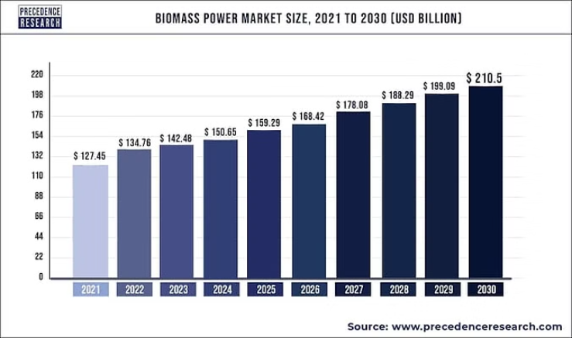
The biomass industry has experienced significant growth in recent years, driven by factors such as increasing awareness of renewable energy sources, government incentives, technological advancements, and the need to reduce carbon emissions. This growth is expected to continue as more countries and industries transition towards sustainable energy solutions. Additionally, innovations in biomass conversion technologies are expanding the range of biomass feedstocks that can be efficiently utilized, further fueling industry expansion.

Slide 12
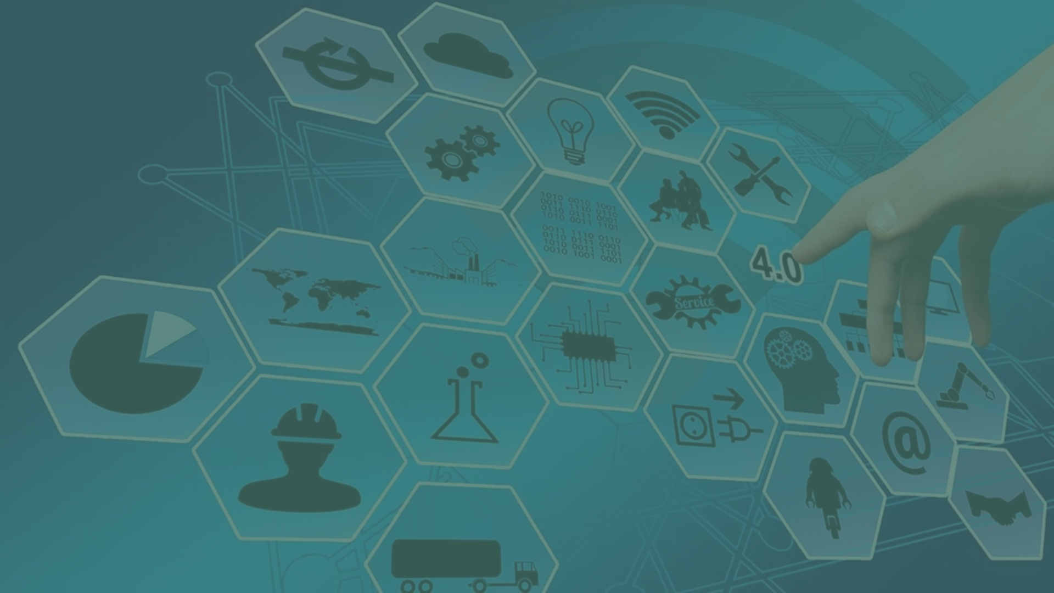
Software Technologies
Technologies used to create website are HTML , CSS , JAVA SCRIPT
HTML (Hyper Text Markup Language): HTML is the standard markup language used to create the structure and content of web pages. It defines the elements and their layout on a web page, such as headings, paragraphs, images, links, and more.
CSS (Cascading Style Sheets): CSS is used to style the HTML elements, defining how they look and are presented on the web page. It controls the layout, colors, fonts, and other visual aspects of a website, making it visually appealing and user-friendly.
JavaScript: JavaScript is a programming language that adds interactivity and dynamic behavior to web pages. It allows you to create responsive and interactive elements such as animations, form validations, and interactive maps, enhancing the user experience.
My SQL DATABASE: Database is used to store the data of industries and hotels.

Slide 13
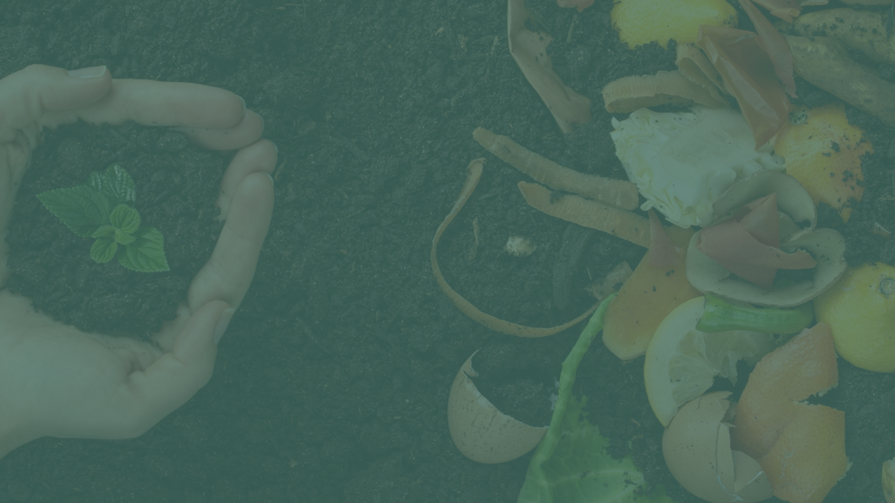
Conclusion
In conclusion, the development of a website to facilitate communication and collaboration between hotels and industries for organic waste management presents a sustainable solution to reduce food waste, promote resource recovery, and foster environmental sustainability. By bridging the gap between surplus food generation in hotels and the potential for conversion into biogas, vermicompost, or animal feed in industries, the project not only addresses immediate environmental challenges but also lays the foundation for long-term sustainable practices. Through the implementation of innovative technologies, effective communication channels, and community engagement strategies, the project has the potential to create a positive impact on the environment, economy, and society, contributing to a more sustainable and circular economy.

Slide 14
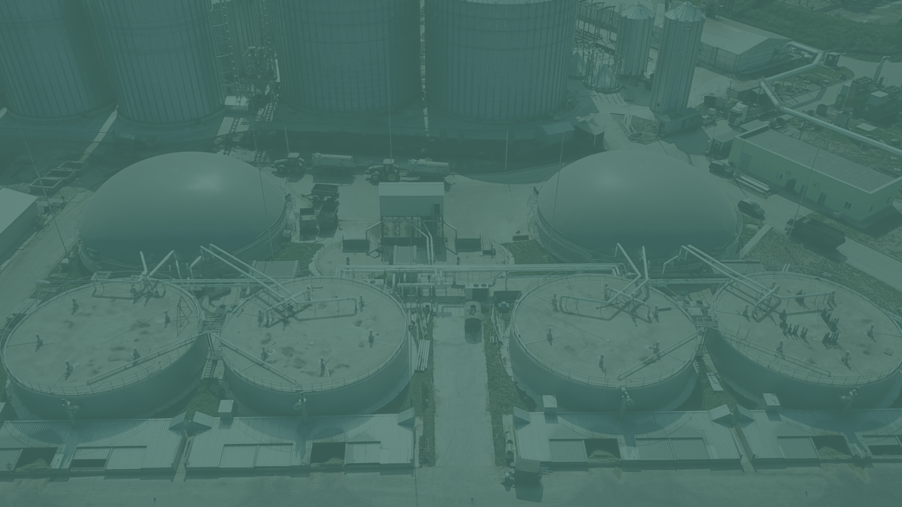
Thank You

